Slide 1


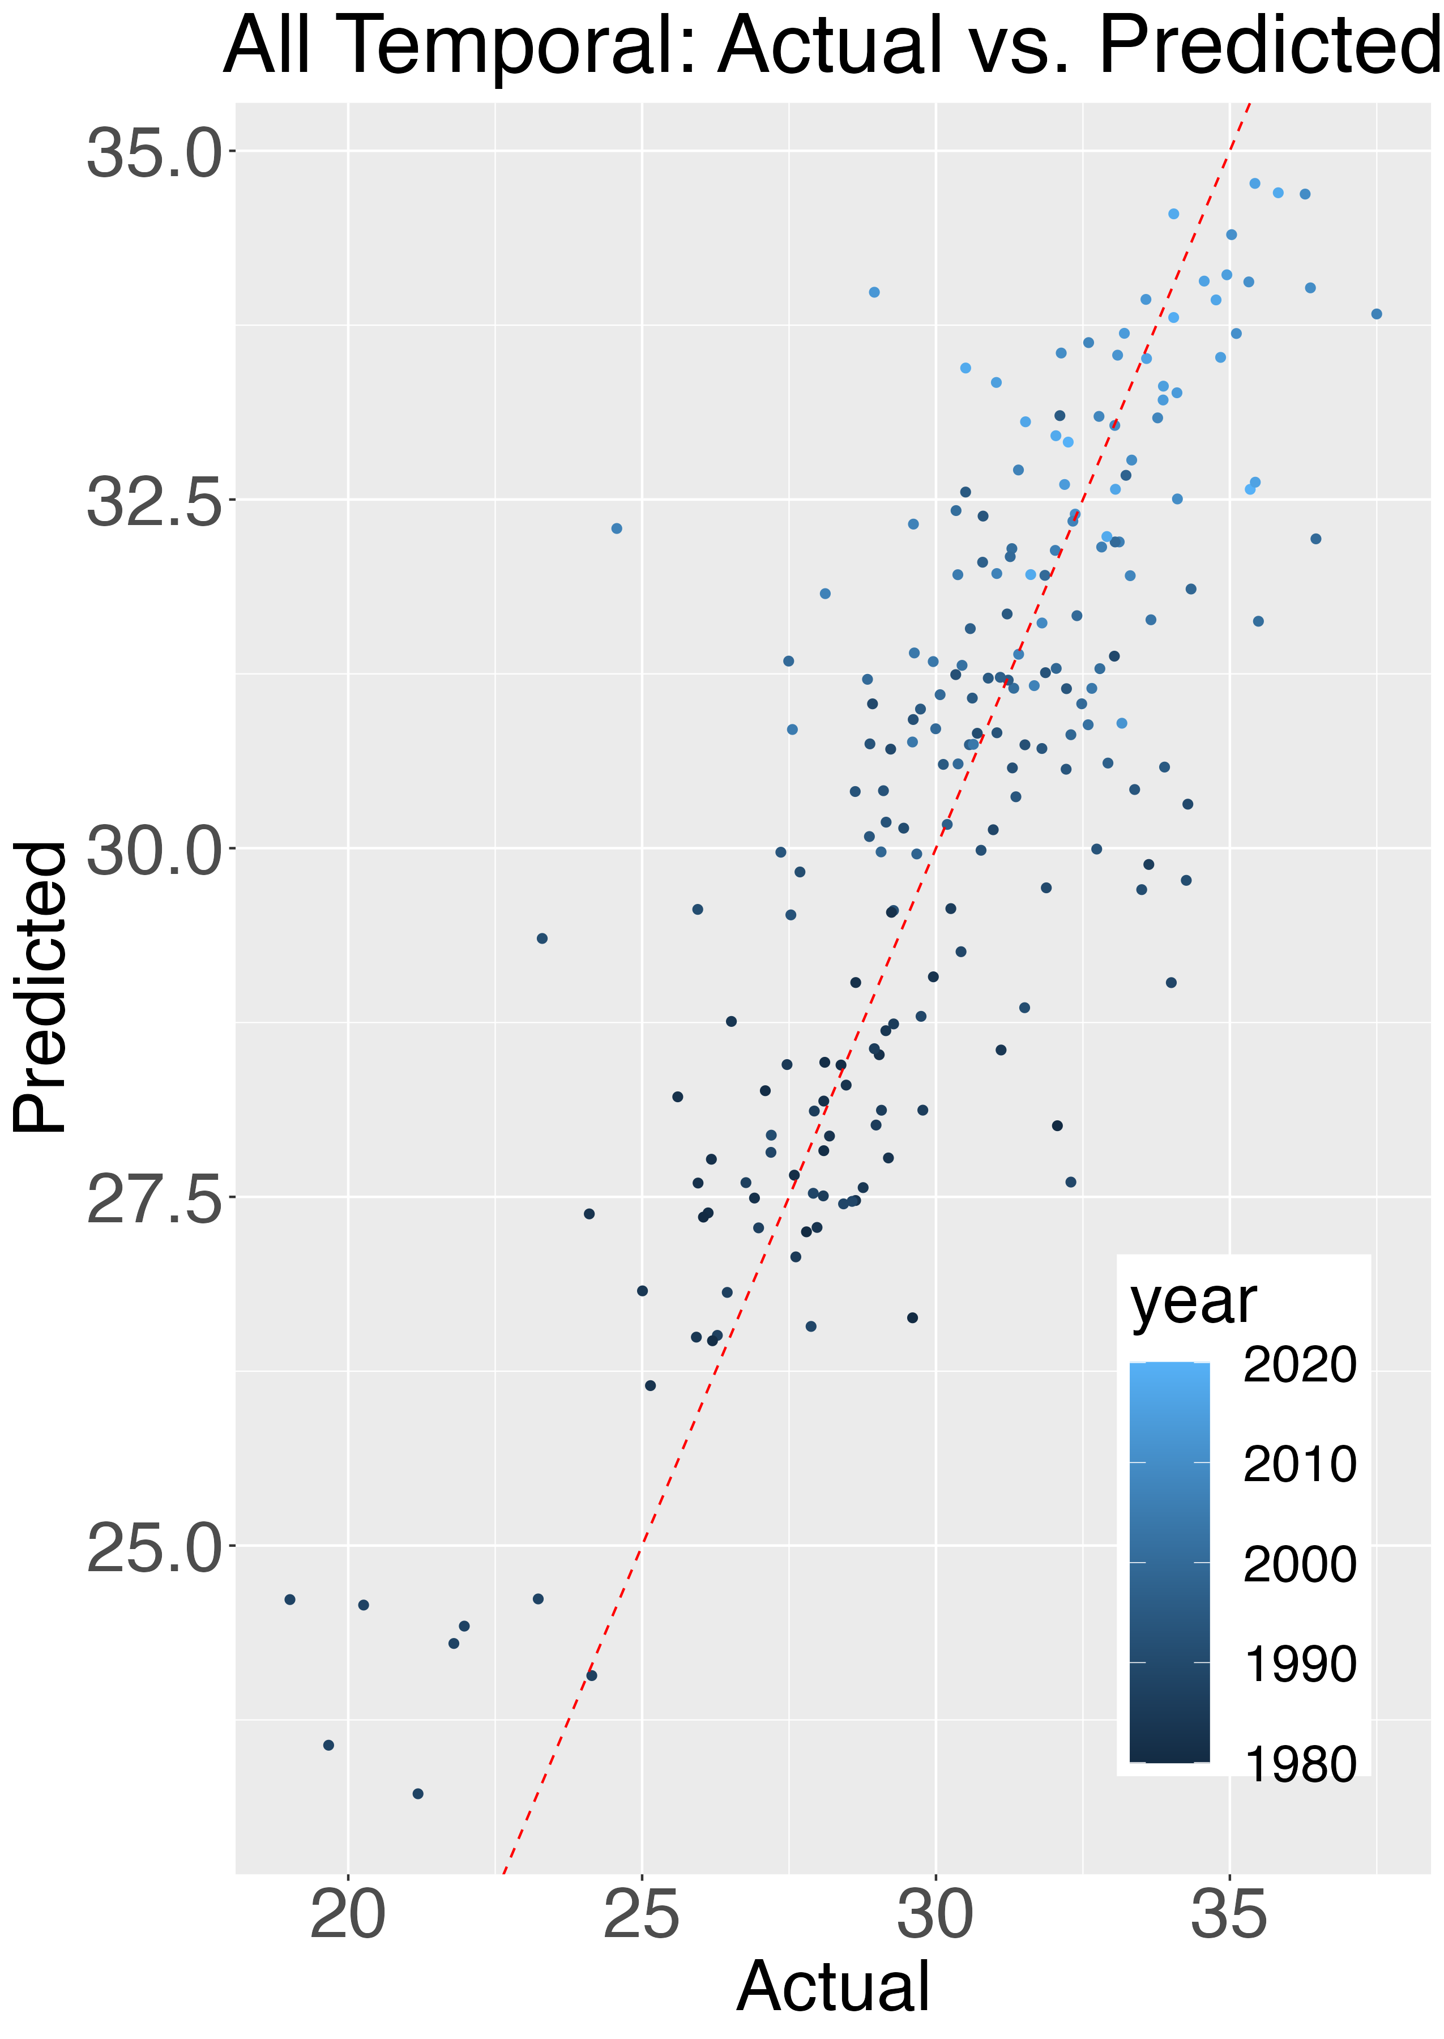
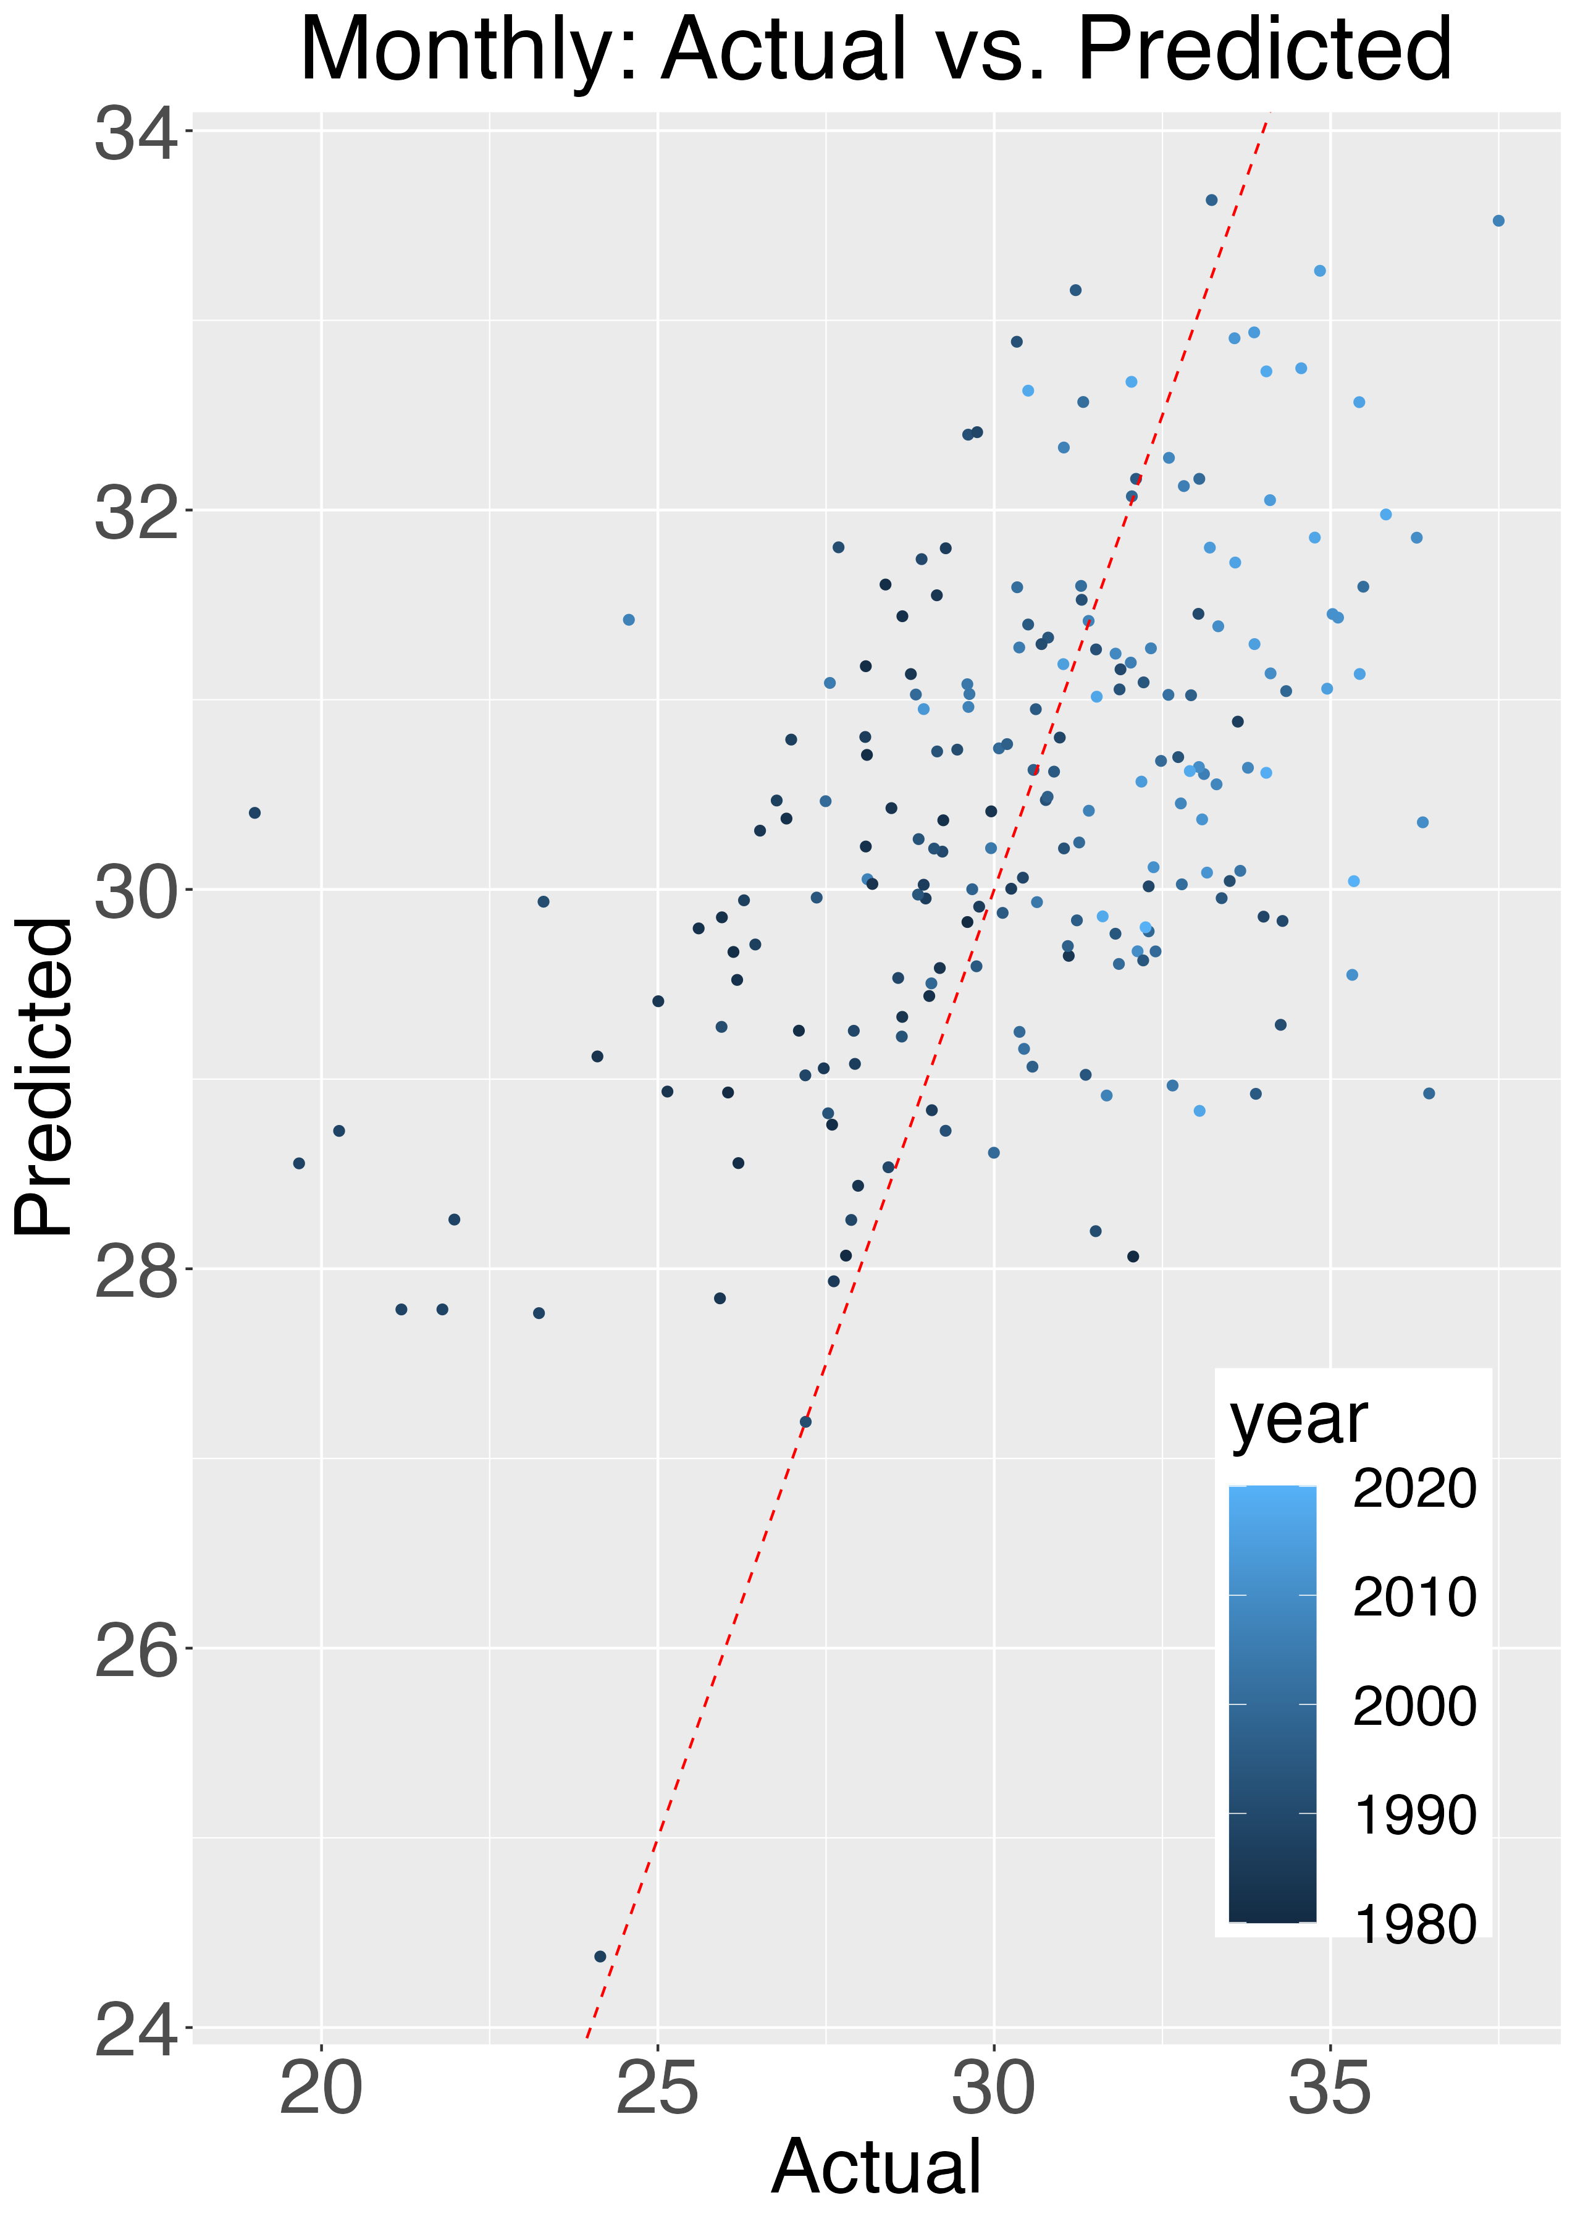
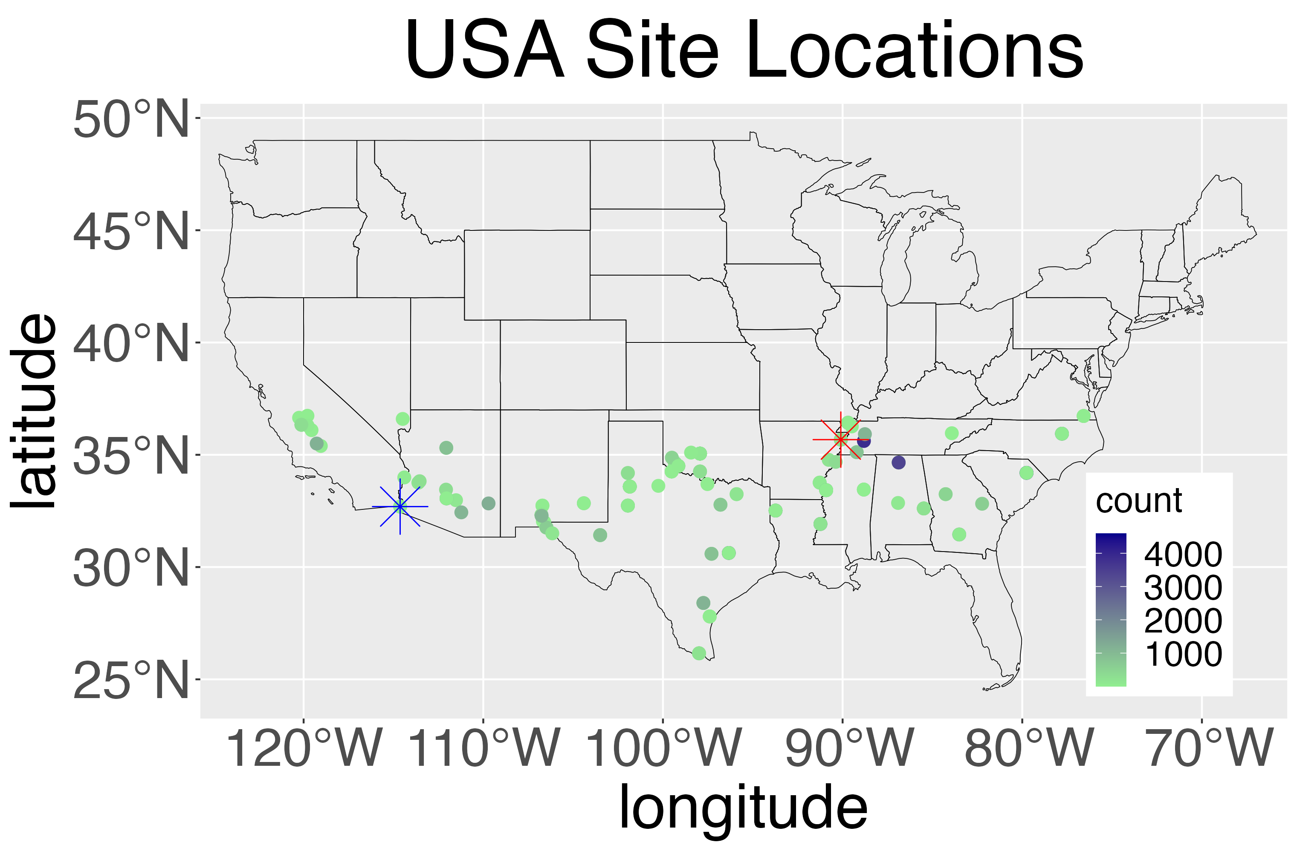
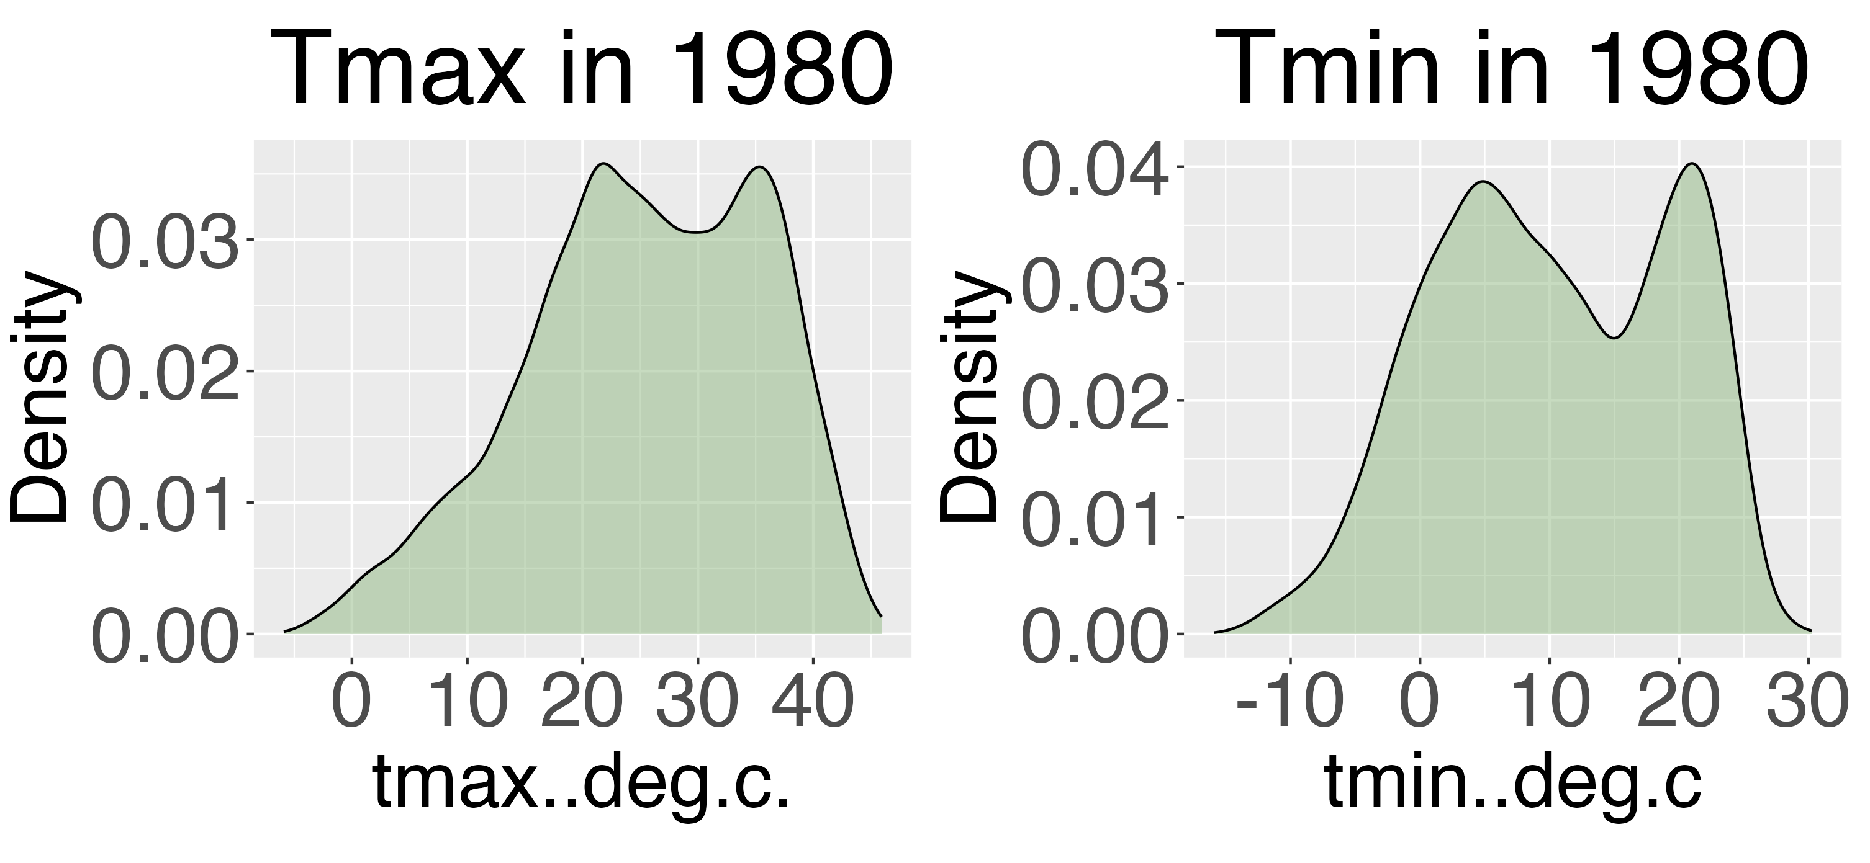
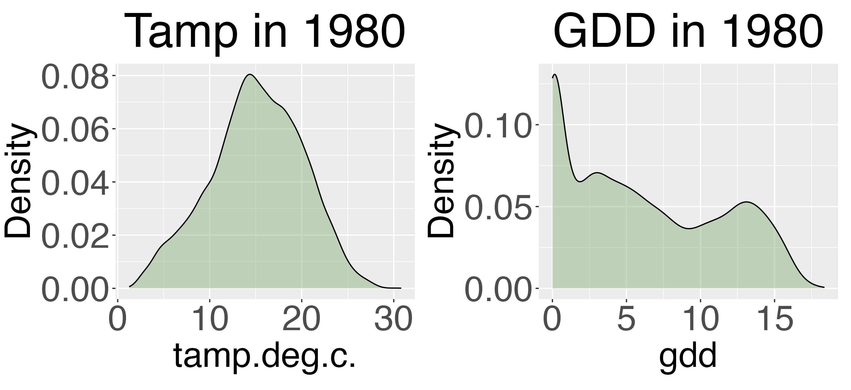
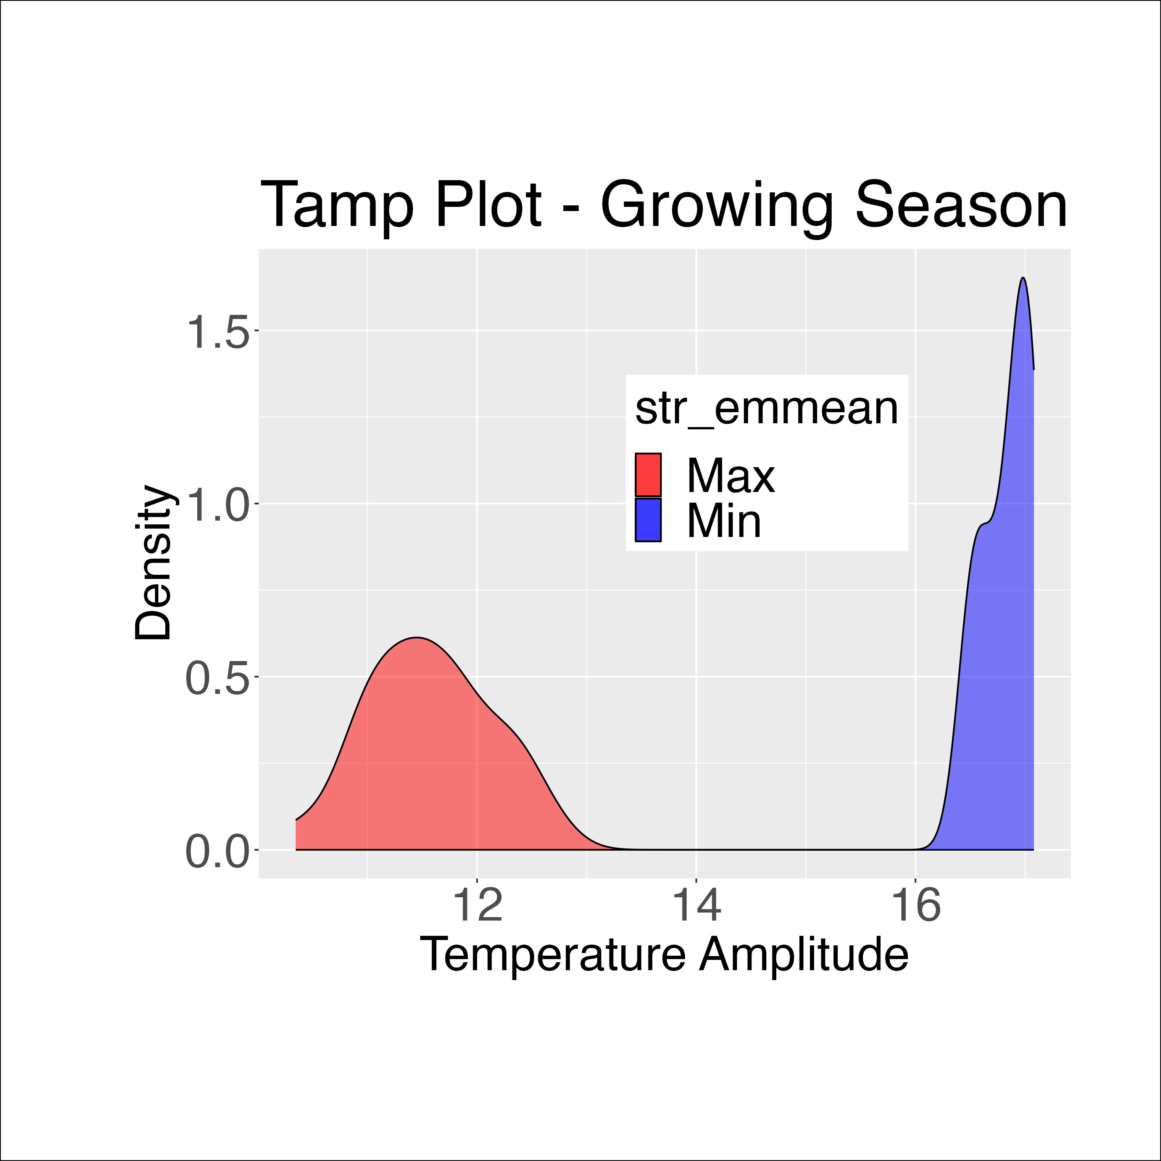
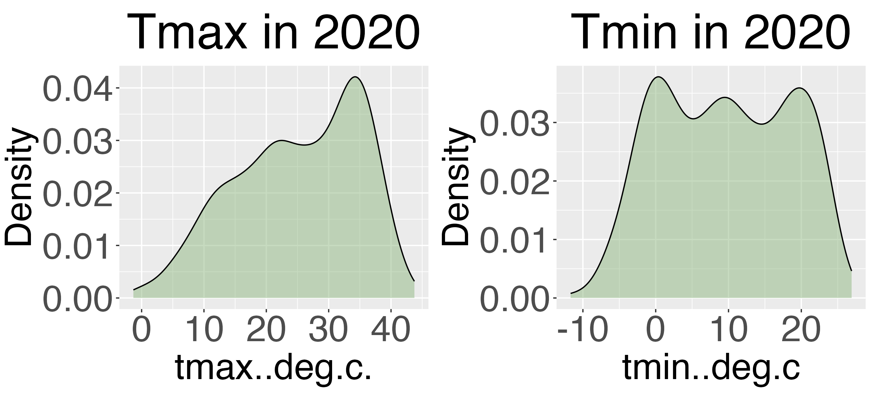
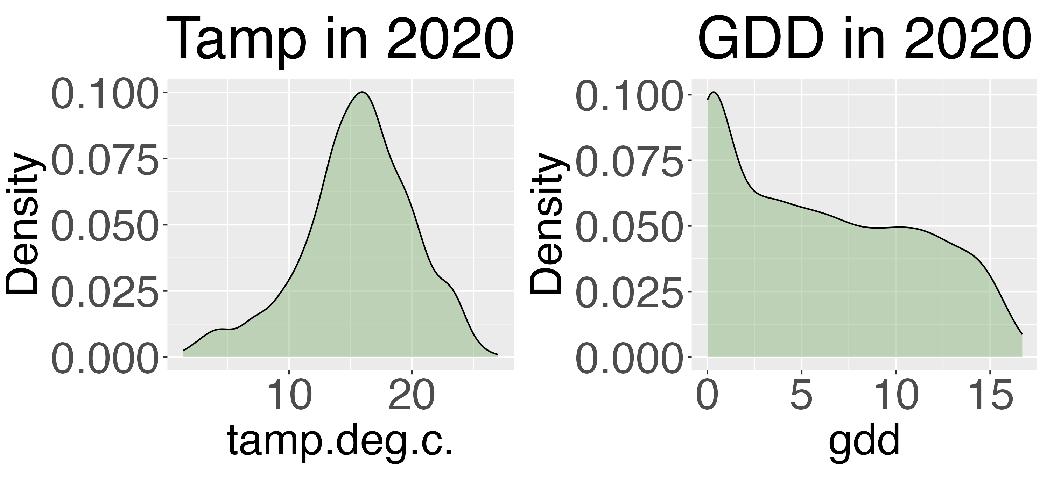
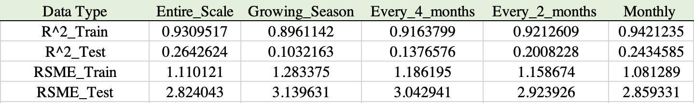

Weather Impacts on Cotton Strength: A Comprehensive 40-Year Analysis
Catherine Chu, Dr. Leonardo Bastos
Introduction
Results
Cotton, a vital and versatile crop, holds immense economic importance. As cotton producers strive to optimize yield and quality, understanding the factors that influence cotton fiber characteristics becomes important. Among these factors, weather plays a pivotal role, affecting cotton growth and development throughout its lifecycle. By identifying the key weather variables that impact cotton fiber quality, we can facilitate informed decision-making for cotton producers and agricultural researchers.
Objective
To investigate the correlation of weather data on cotton strength through an extensive analysis of a multi-year dataset.
Methodology
Primary
Secondary
Data Collection: Forty years of data were scraped.
Data Cleaning: The collected data underwent a cleaning process.
Data Integration: The cleaned data from the 40-year period were combined into a single dataset for further analysis.
Weather Data Retrieval: Daily weather data for the 40-year period was aggregated into monthly, bimonthly, 4-monthly, and growing season periods.
Secondary Weather Data: Derived weather variables such as tamp and gdd were extracted from the primary weather data.
Machine Learning Analysis: The weather data were used to train a Random Forest machine learning algorithm
Variable Importance: The analysis determined the top weather variables that significantly impact cotton strength.
Summarized
Conclusion
R-Squared and RSME for Random Forest Algorithm
In conclusion, the research has identified temperature amplitude as the top weather variable that significantly influences cotton strength and fiber quality.
Thank to our sponsors: National Institute of Food and Agriculture | United States Department of Agriculture

